Slide 1
IoT Internet Protocols
黃仁竑 教授
國立中正大學資工系

Slide 2
Outline
IPv6
6LoWPAN
RPL
CoAP
MQTT
XMPP

Slide 3
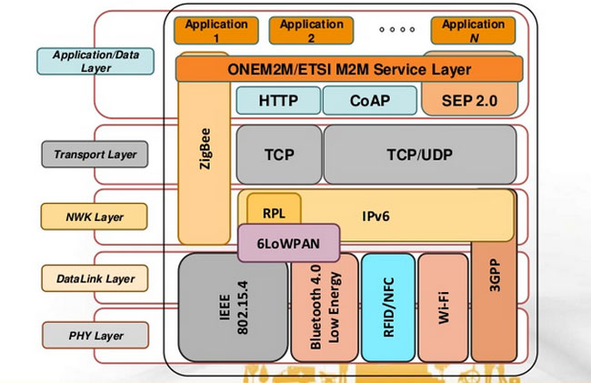
IoT Protocol Stack
Source: https://www.postscapes.com/internet-of-things-protocols/
https://www.slideshare.net/butler-iot/butler-project-overview-13603599

Slide 4
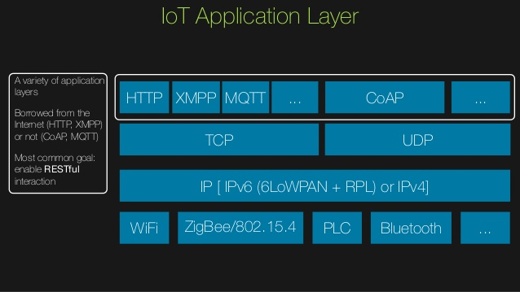
IoT Protocol Stack
Source: https://www.slideshare.net/MarcoPicone/the-android-platform-in-the-era-of-internet-of-things-droidcon-italy-2014

Slide 5
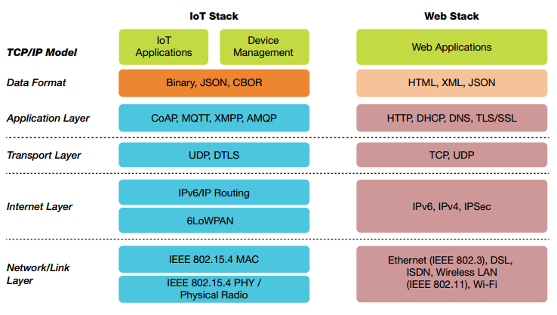
IoT vs. Internet Protocol Stack
Source https://www.linkedin.com/pulse/emerging-open-standard-protocol-stack-iot-aniruddha-chakrabarti

Slide 6
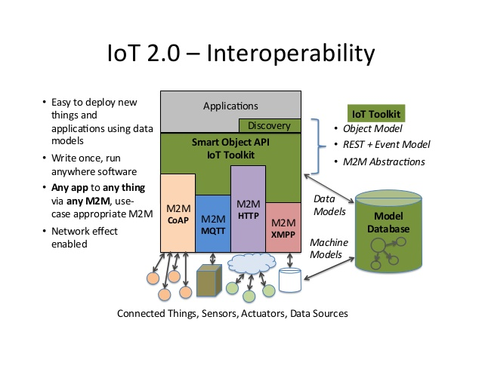
IoT 2.0 Interoperability
Source: https://www.slideshare.net/michaeljohnkoster/opensourcestackforiot-131017193902phpapp02

Slide 7
Internet Protocol Version 6 (IPv6)
Ren-Hung Hwang

Slide 8
IPv6
Problems with IPv4
Shortage of address space
Lack of Quality of Service guarantee
New features of IPv6
Enlarge address space
Fixed header format helps speed processing/forwarding
Better support for Quality of Service
Neighbor discovery and Auto-configuration
Hierarchical address architecture (improved address aggregation)
new “anycast” address: route to “best” of several replicated servers

Slide 9
IPv6 Header

Slide 10
IPv6 Header
Version: 6
Traffic class:
identify class of service
E.g., DiffServ (DS codepoint)
The 6 most-significant bits are used for DSCP
Flow Label:
identify datagrams in same “flow”
Next header:
identify upper layer protocol for data

Slide 11
Changes from IPv4 (1/3)

Slide 12
Changes from IPv4 (2/3)
Expanded Addressing Capabilities
from 32 bits to 128 bits (more level and nodes)
improve multicast routing (“scope” field)
“anycast address”: send a packet to any one of a group of nodes
Header Format Simplification
reduce bandwidth cost
Extensions
more flexibility

Slide 13
Changes from IPv4 (3/3)
Checksum
removed to reduce processing at routers
Fragmentation
Not allowed at intermediate routers

Slide 14
6LoWPAN(RFC 6282): IP on IEEE 802.15.4 Low-Power Wireless Networks
黃仁竑 教授
國立中正大學資工系

Slide 15
Outline
What is 6LoWPAN?
Motivation and Goal
Key Elements
Topology
6LoWPAN Adaptation Layer

Slide 16
What is 6LoWPAN?
6LoWPAN is an acronym of IPv6 over Low power Wireless Personal Area Networks.
It is designed by the 6LoWPAN working group in IETF (Internet Engineering Task Force).
RFC 4919 included a detailed review of requirements, which were released in 2007.
Notes:
6LoWPAN 是 IPv6 在低功率無線個人區域網路的縮寫
IETF 6LoWPAN 工作組負責設計一適配層界接IPv6及低功耗網路。
工作組在2007年發佈RFC 4919, 詳細說明要求

Slide 17
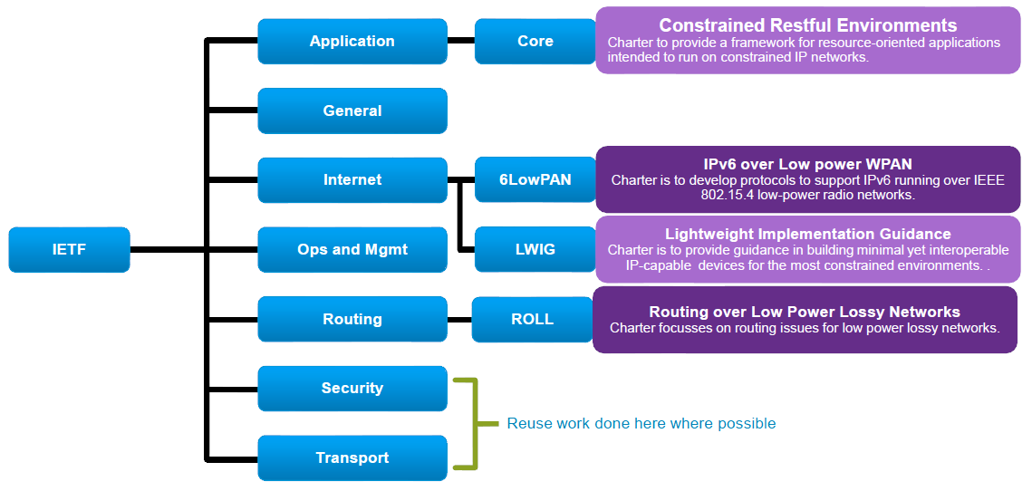
IETF Low Power Lossy Network Related Working Groups

Slide 18
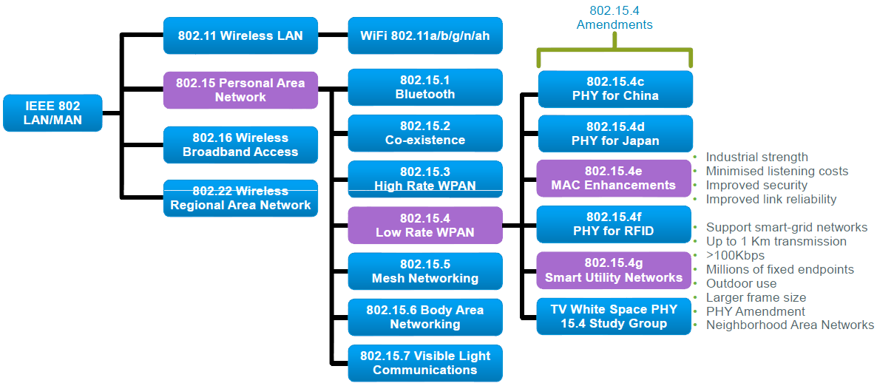
IEEE Wireless Standards

Slide 19
6LoWPAN WG Documents
draft-ietf-6lowpan-btle-11 | Transmission of IPv6 Packets over BLUETOOTH Low Energy | 2012-10-12
RFC 4919 (draft-ietf-6lowpan-problem) | IPv6 over Low-Power Wireless Personal Area Networks (6LoWPANs): Overview, Assumptions, Problem Statement, and Goals | 2007-08
RFC 4944* (draft-ietf-6lowpan-format) | Transmission of IPv6 Packets over IEEE 802.15.4 Networks | 2007-09
RFC 6282 (draft-ietf-6lowpan-hc) | Compression Format for IPv6 Datagrams over IEEE 802.15.4-Based Networks | 2011-09
RFC 6568 (draft-ietf-6lowpan-usecases) | Design and Application Spaces for IPv6 over Low-Power Wireless Personal Area Networks (6LoWPANs) | 2012-04
RFC 6606 (draft-ietf-6lowpan-routing-requirements) | Problem Statement and Requirements for IPv6 over Low-Power Wireless Personal Area Network (6LoWPAN) Routing | 2012-05
RFC 6775 (draft-ietf-6lowpan-nd) | Neighbor Discovery Optimization for IPv6 over Low-Power Wireless Personal Area Networks (6LoWPANs) | 2012-11 new
*RFC 4944 (Proposed Standard) Updated by RFC 6282, RFC 6775

Slide 20
6LoWPAN WG Documents
RFC 7388 | Definition of Managed Objects for IPv6 over Low-Power Wireless Personal Area Networks (6LoWPANs) | 2014-10
RFC 7400 | 6LoWPAN-GHC: Generic Header Compression for IPv6 over Low-Power Wireless Personal Area Networks (6LoWPANs) | 2014-11

Slide 21
Motivation
Traditionally, battery-powered networks or low-bitrate networks, such as most fieldbus networks or 802.15.4 were considered incapable of running IP.
In the home and industrial automation networks world, the situation compares to the situation of corporate LANs in the 1980s: “should I run Token-Ring, ATM or IPX/SPX?” translates to “should I run ZigBee, LON or KNX?”
Notes:
Fieldbus 是一個全數位，序列雙向迴路，多點信號通信系統.
傳統上，電池供電的網路或低頻寬的網路，如大多數現場總線網路或802.15.4被認為是不能運行IP協議的。

Slide 22
Motivation
IP, with its concept of layer 3 routing and internetwork technology, has made those debates about incompatible networks obsolete:
the vast majority of LANs and WANs today run IP, and many people can hardly remember which layer 2 technology their IP networks are running on.
Notes:
當年與第三層路由和網路技術概念的IP與一些不兼容的網路爭論已無人再提及：
今天絕大多數運行IP的區域網路和廣域網路，很多人都很難記得那些第2層的技術在運行。

Slide 23
Motivation
Almost any layer 2 technology can be used and will simply extend the IP internetwork.
The same transition to IP is now happening in the home and industrial automation worlds. 6LoWPAN and RPL have made this possible.
Notes:
第2層技術大都可以被使用並簡單的擴展的IP網路。
一樣的過渡至IP現在發生在家庭和工業自動化世界。
6LoWPAN和RPL有這樣的可能。

Slide 24
Goal of 6LowPAN
Traditional way: 2-stage
End-to-end IP transmission
IPv6 packet,
all the way
to IoT devices
IP packet
IPv6 gateway
(adaption)
WSN gateway
propriety WSN
packet (e.g., ZigBee)

Slide 25
Constraints of LoWPAN
Low-cost nodes communicating over multiple hops to cover a large geographical area
Operate unattended for years on modest batteries.
Capabilities are more limited
small frame sizes, low bandwidth, and low transmit power, limited memory and compute power.
Proprietary protocols and link-only solutions, presuming that IP was too memory and bandwidth-intensive

Slide 26
Key Factors for IP over 802.15.4
Header
Standard IPv6 header is 40 bytes [RFC 2460]
Entire 802.15.4 MTU is 127 bytes [IEEE 802.15.4]
Often data payload is small
Fragmentation
Interoperability means that applications need not know the constraints of physical links
IP packets may be large, compared to 802.15.4 max frame size
IPv6 requires all links support 1280 byte packets [RFC 2460]

Slide 27
Key Factors for IP over 802.15.4
Allow link-layer mesh routing under IP topology
802.15.4 subnets may utilize multiple radio hops per IP hop
Similar to LAN switching within IP routing domain in Ethernet
Allow IP routing over a mesh of 802.15.4 nodes
Options and capabilities already well-defined
Various protocols to establish routing tables

Slide 28
Topology
6LoWPAN network can be organized around three topologies:
Star topology
Meshed
Routed
Notes:
6LoWPAN拓譜可分為下列三種:
Star topology
Meshed
Routed

Slide 29
Star topology
All sensor nodes can reach and are reachable from the LBR(LoWPAN Border Router)
Notes:
所有的感測器可以透過LBR到達

Slide 30
Meshed
Nodes are organized at Layer 2 in order to relay frames toward the destination.
From point of view of the Internet, a meshed network is similar to an Ethernet network where every node shares the same prefix.
6LoWPAN refers to that technology as mesh-under (MU).
Notes:
節點在第二層組織，為了轉傳至目的地
縱觀整個網際網路，meshed 網路跟 Ethernet 網路相似因為每個節點使用相同的
6LoWPAN將此技術稱為mesh-under

Slide 31
Routed
Nodes act as routers and forward packets toward the destination.
Nodes acting as a router inside the LoWPAN network and not directly connected to the Internet are called LoWPAN routers(LRs).
6LoWPAN refers to that technology as route-over(RO). The best example is RPL protocol.
Notes:
節點會像路由器一樣轉送封包到目的地
節點作為路由器在內部LoWPAN網絡，而不是直接連接到Internet被稱為LoWPAN路由器
6LoWPAN將此技術稱為router-over

Slide 32
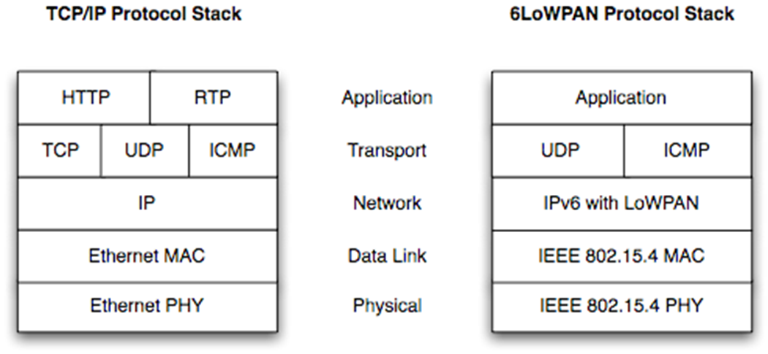
6LoWPAN Protocol Stack

Slide 33
6LoWPAN Key Elements
6LoWPAN introduces an adaptation layer between the IP stack’s link and network layers to enable efficient transmission of IPv6 datagrams over 802.15.4 links
Provides header compression to reduce transmission overhead
Fragmentation to support the IPv6 minimum MTU requirement
Support for layer-two forwarding to deliver and IPv6 datagram over multiple radio hops

Slide 34
Key Concept
Use of stateless or shared-context compression to elide adaptation, network, and transport layer header fields
Compressing all three layers down to a few bytes.
It’s possible to compress header fields to a few bits when we observe that they often carry common values, reserving an escape value for when less-common ones appear.

Slide 35
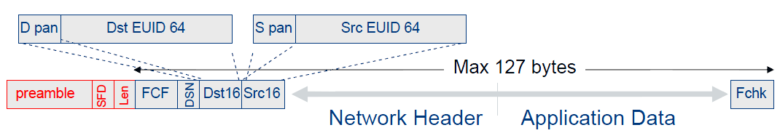
IEEE 802.15.4 Frame Format
Octets:2 | 1 | 0/2 | 0/2/8 | 0/2 | 0/2/8 | 0/5/6/10/14 | Variable | 2
Frame Control | Sequence Number | Dest. PAN Identifier | Dest. Address | Source PAN Identifier | Source Addr. | Auxiliary Security Header | Frame Payload | FCS
 |  | Addressing fields |  |  |  |  | MAC Payload | MFR
MHR

Slide 36
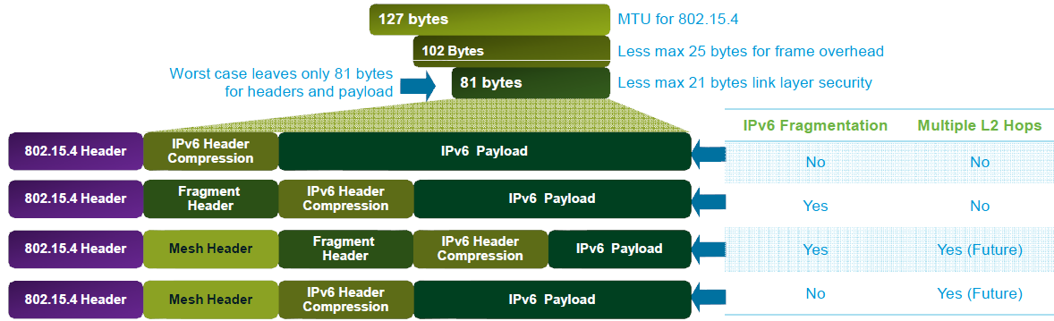
Typical 6LoWPAN Header Stacks

Slide 37
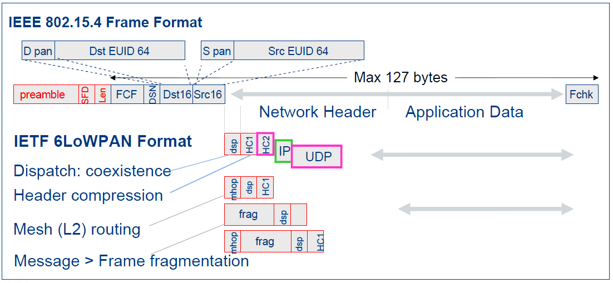
6LoWPAN Format Design
Orthogonal stackable header format
Almost no overhead for the ability to interoperate and scale.
Pay for only what you use

Slide 38
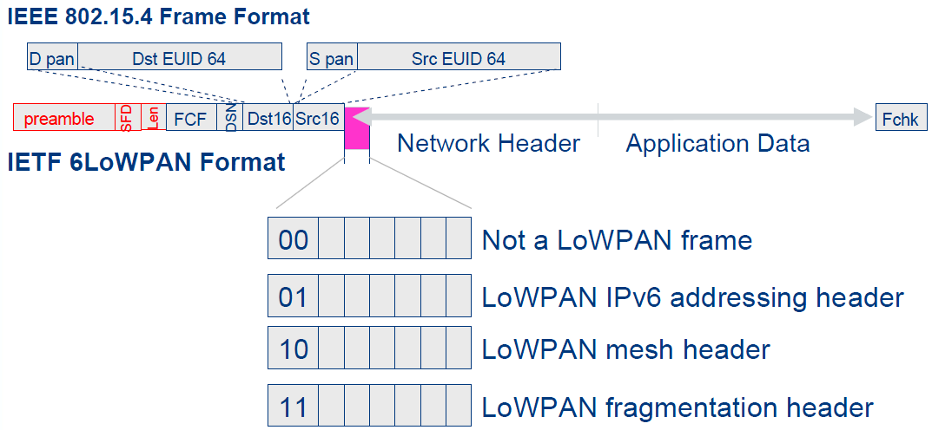
6LoWPAN – The First Byte
Coexistence with other network protocols over same link
Header dispatch - understand what’s coming

Slide 39
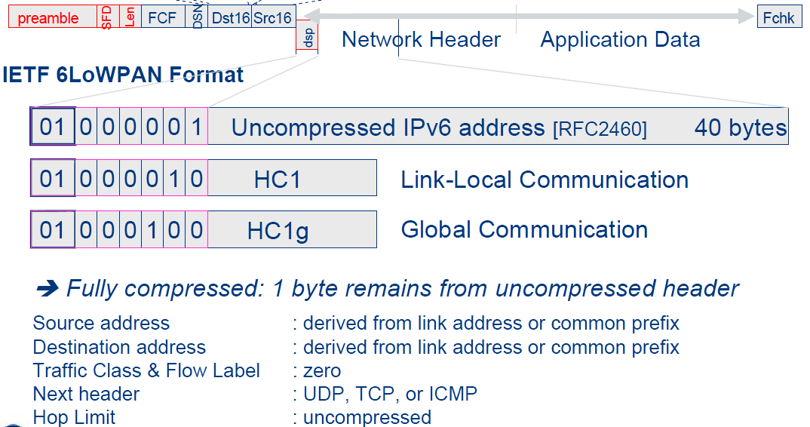
6LoWPAN – IPv6 Header

Slide 40
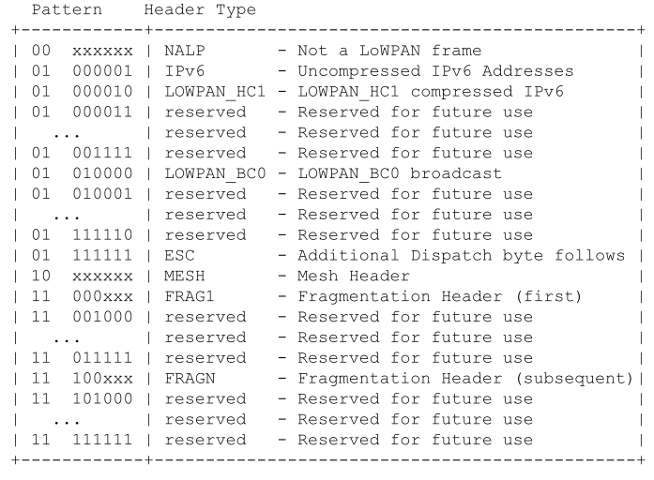
Dispatch Value Bit Pattern

Slide 41
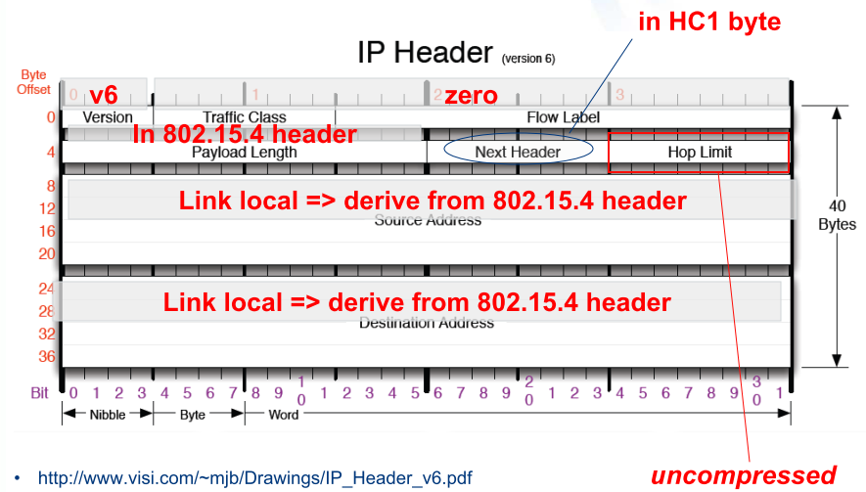
IPv6 Header Compression

Slide 42
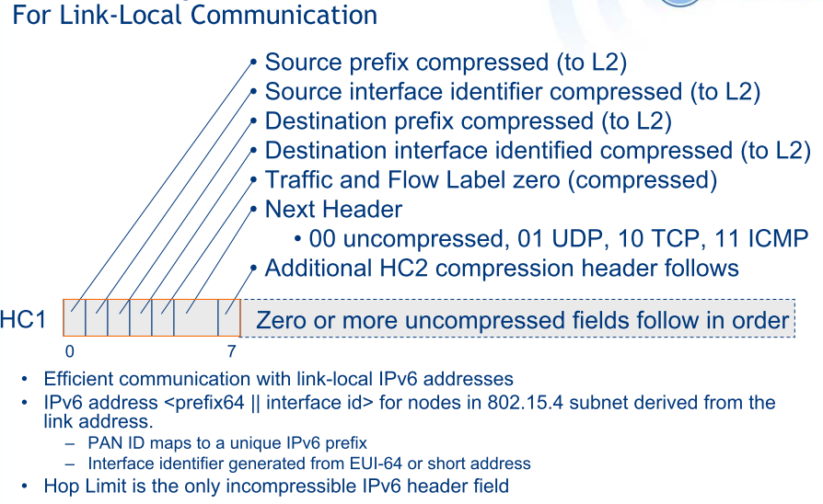
HC1 Compressed IPv6 Header [4944]

Slide 43
LOWPAN_HC1 (common compressed header encoding)
The address fields encoded by "HC1 encoding" are interpreted as follows:
Source/Destination Prefix compression
PI(0): Prefix carried in-line (Section 10.3.1).
PC(1): Prefix compressed (link-local prefix assumed).
Source/Destination Interface ID compression
II(0): Interface identifier carried in-line (Section 10.3.1).
IC(1): Interface identifier elided (derivable from the corresponding link-layer address).

Slide 44
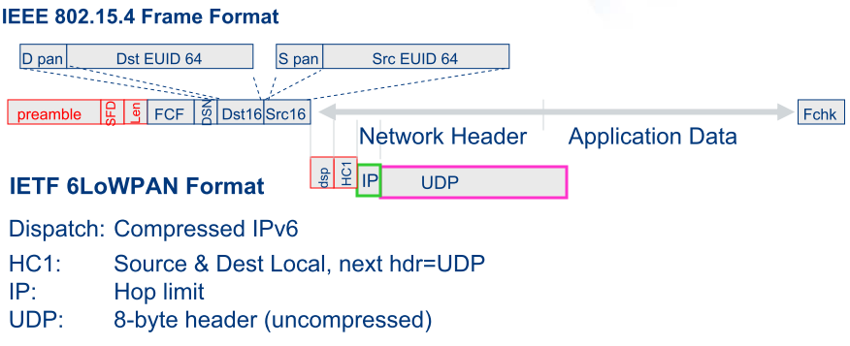
6LoWPAN – Compressed / UDP or ICMP
HC2 bit is not set
ICMP: 8-byte header (uncompressed)

Slide 45
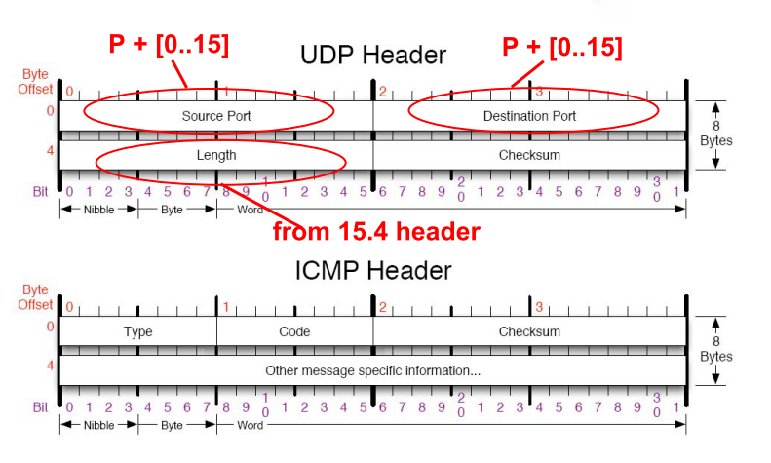
L4 – UDP/ICMP Headers (8 bytes)

Slide 46
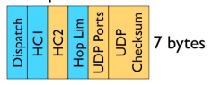
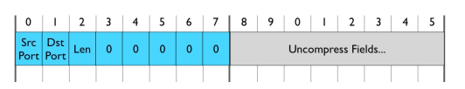
6LoWPAN – Compressed / Compressed UDP
IP: 3 bytes
UDP: 4 bytes (compressed indicator, ports, checksum)
HC2 bit is set
HC2 (HC_UDP)
6LoWPAN introduces a range of well-known ports (61616 – 61631).
When ports fall in the well-known range, the upper 12 bits may be elided.
HC2 also allows elision of the UDP Length, as it can be derived from the IPv6 Payload Length field.

Slide 47
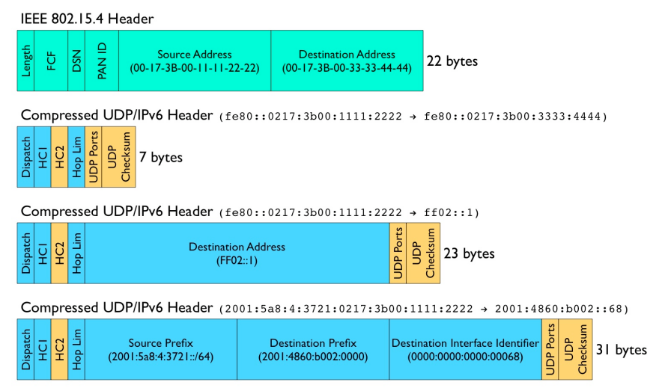
6LoWPAN IPv6/UDP Compression Examples
(link local -> link local)
(link local -> local multicast)
(link global -> link global)

Slide 48
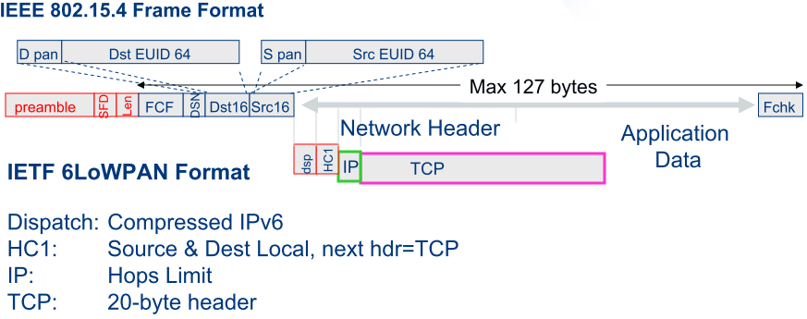
6LoWPAN – Compressed / TCP

Slide 49
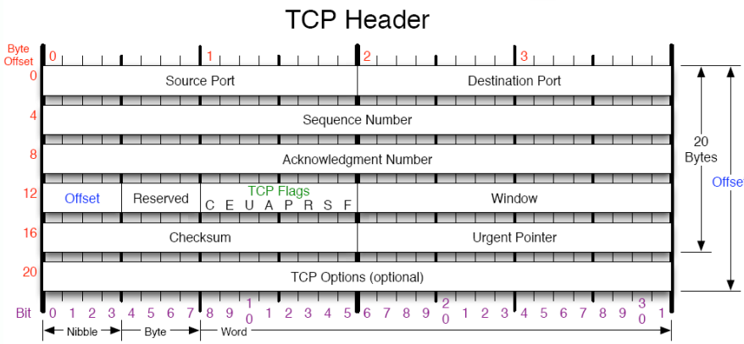
TCP Header

Slide 50
LOWPAN_IPHC, NHC [RFC 6282]
Common case assumption
Version is 6
Traffic Class and Flow Label are both zero
Payload Length can be inferred from lower layers
Hop Limit will be set to a well-known value
Source addresses is formed using the link-local prefix or a small set of routable prefixes
Addresses assigned to 6LoWPAN interfaces are formed with an IID derived directly from either the 64-bit extended or the 16-bit short IEEE 802.15.4 addresses.

Slide 51
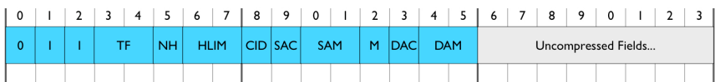
6LoWPAN Improved IPv6 Header Compression [RFC 6282]
IPHC
TF: Traffic Class and Flow Label to be individually compressed
2-bit Explicit Congestion Notification (ECN) and 6-bit Differentiated Services Code Point (DSCP)
00: ECN + DSCP + 4-bit Pad + Flow Label (4 bytes)
01: ECN + 2-bit Pad + Flow Label (3 bytes), DSCP is elided.
10: ECN + DSCP (1 byte), Flow Label is elided.
11: Traffic Class and Flow Label are elided.
NH: Next Header
0: Full 8 bits for Next Header are carried in-line.
1: The Next Header field is compressed and the next header is encoded using LOWPAN_NHC

Slide 52
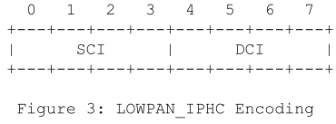
6LoWPAN Improved IPv6 Header Compression [RFC 6282]
IPHC
HLIM: Hop Limit compression when common values
00: The Hop Limit field is carried in-line.
01: The Hop Limit field is compressed and the hop limit is 1.
10: The Hop Limit field is compressed and the hop limit is 64.
11: The Hop Limit field is compressed and the hop limit is 255.
Context Identifier(CID): Makes use of shared-context to elide the prefix from IPv6 addresses (two additional 4-bit fields)
0: No additional 8-bit Context Identifier Extension is used (either Source Address Compression (SAC) or Destination Address Compression (DAC)).
1: An additional 8-bit Context Identifier Extension field immediately follows the Destination Address Mode (DAM) field.

Slide 53
6LoWPAN Improved IPv6 Header Compression [RFC 6282]
IPHC
Source Address Compression (SAC) indicates whether stateless compression is used
0: Source address compression uses stateless compression.
1: Source address compression uses stateful, context-based compression.
Source Address Mode (SAM) indicates whether the full Source Address is carried inline, upper 16 or 64-bits are elided, or the full Source Address is elided.
If SAC=0:
00: 128 bits
01: 64 bits (network prefix elided, use link-local prefix)
10: 16 bits (first 112 bits elided); 0000:00ff:fe00:XXXX
11: 0 bits.
Zigbee short address

Slide 54
6LoWPAN Improved IPv6 Header Compression [RFC 6282]
IPHC
Source Address Mode (SAM)
If SAC=1:
00: The UNSPECIFIED address, ::
01: 64 bits. (other address bits are derived using context information)
10: 16 bits. (using context information + 0000:00ff:fe00:XXXX)
11: 0 bits. The address is fully elided and is derived using context information and the encapsulating header (e.g., 802.15.4 or IPv6 source address)
M: Supports multicast addresses most often used for IPv6 ND and SLAAC.
0: Destination address is not a multicast address.
1: Destination address is a multicast address.

Slide 55
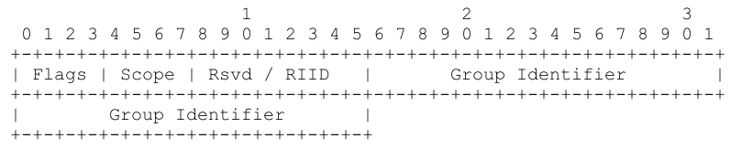
6LoWPAN Improved IPv6 Header Compression [RFC 6282]
IPHC
M:
If M=1 and DAC=0, DAM:
00: 128 bits. The full address is carried in-line.
01: 48 bits. The address takes the form ffFS::00GGGGGG:GGGG. (F: Flag, S: Scope)
10: 32 bits. The address takes the form ffFS::00GG:GGGG. (G: Group id)
11: 8 bits. The address takes the form ff02::00GG.
If M=1 and DAC=1, DAM:
00: 48 bits. This format is designed to match Unicast-Prefix-based IPv6 Multicast Addresses as defined in [RFC3306] and [RFC3956]. The multicast address takes the form ffXX:XXLL:PPPP:PPPP:PPPP:PPPP:XXXX:XXXX. (Prefix Length and Network Prefix can be taken from a context)
01, 10, 11: reserved

Slide 56
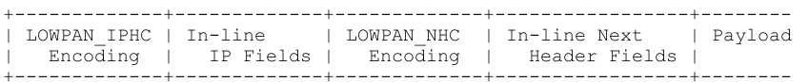
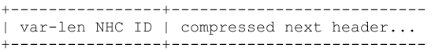
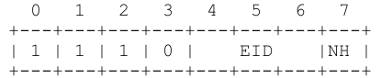
Next Header Compression (NHC)
NH=1 in IPHC indicates the use of LOWPAN_NHC
LOWPAN_NHC Format
IPv6 Extension Header Encoding
EID: IPv6 Extension Header ID:
0: IPv6 Hop-by-Hop Options Header [RFC2460]
1: IPv6 Routing Header [RFC2460]
2: IPv6 Fragment Header [RFC2460]
3: IPv6 Destination Options Header [RFC2460]
4: IPv6 Mobility Header [RFC6275]
5: Reserved
6: Reserved
7: IPv6 Header (NH must be 0; MUST be encoded using LOWPAN_IPHC )
NH: Next Header:
0: Full 8 bits for Next Header are carried in-line.
1: Next Header is elided, next header is encoded using LOWPAN_NHC

Slide 57
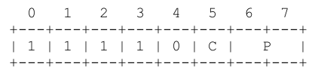
UDP NHC Format
C: Checksum:
0: All 16 bits of Checksum are carried in-line.
1: All 16 bits of Checksum are elided. The Checksum is recovered by re-computing it on the 6LoWPAN termination point.
P: Ports:
00: All 16 bits for both Source Port and Destination Port are carried in-line.
01: All 16 bits for Source Port are carried in-line. First 8 bits of Destination Port is 0xf0 and elided. The remaining 8 bits of Destination Port are carried in-line.
10: First 8 bits of Source Port are 0xf0 and elided. The remaining 8 bits of Source Port are carried in-line. All 16 bits for Destination Port are carried in-line.
11: First 12 bits of both Source Port and Destination Port are 0xf0b and elided. The remaining 4 bits for each are carried in-line.

Slide 58
Compressing UDP Checksum
UDP checksum is mandatory with IPv6
In RFC 6282, an endpoint MAY elide the UDP Checksum if it is authorized by the upper layer.
Tunneling: tunneled Protocol Data Unit (PDU) possesses its own addressing, security and integrity check
Message Integrity Check: e.g., IPsec Authentication Header
A decompressor that expands a 6LoWPAN packet with the C bit set MUST compute the UDP Checksum on behalf of the source node and place that value in the restored UDP header as specified in the incumbent standards [RFC0768], [RFC2460].

Slide 59
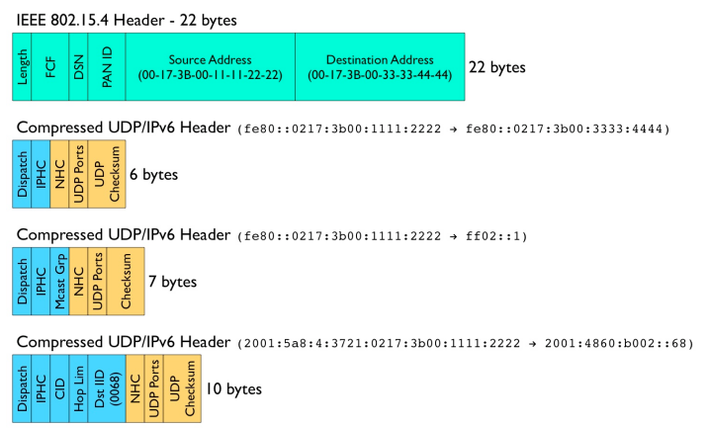
Improved UDP/IPv6 Header Compression Examples
Traffic Class, Flow Label, Payload Length, Next Header, Hop Limit, and link-local prefixes for the IPv6 Source and Destination addresses are all elided.
NHC header defines a new variable length Next Header identifier, allowing for future definition of arbitrary next header compression encodings.

Slide 60
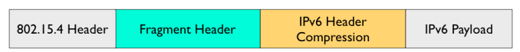
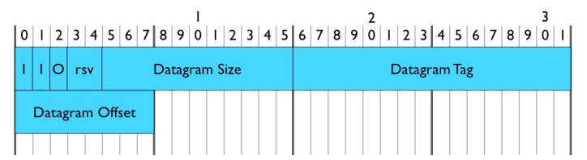
Fragmentation
Datagram Size(11): total size of the unfragmented payload
Datagram Tag(16): ID of the fragmented packet
Datagram Offset(8): in units of 8-byte chunks
The header type is only two bits.
The third bit is used to compress the datagram offset on the first fragment as it is always zero.
The fragment header is 4 bytes for the first fragment and 5 bytes for all subsequent fragments.

Slide 61
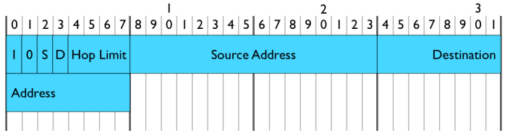
Mesh Addressing Header
Hop Limit: 4 bits
Source Address, and Destination Address: IEEE 802.15.4 link addresses and may carry either a short or extended address.
S/D: short or full address of source/destination address

Slide 62
Conclusion
6LoWPAN turns IEEE 802.15.4 into the next IP-enabled link
Provides open-systems based interoperability among low-power devices over IEEE 802.15.4
Provides interoperability between low-power devices and existing IP devices, using standard routing techniques
Paves the way for further standardization of communication functions among low-power IEEE 802.15.4 devices

Slide 63
RPL: The IP routing protocol designed for low power and lossy networks [RFC 6550]
黃仁竑 教授
國立中正大學資工系

Slide 64
What is RPL?
The IETF Routing Over Low-power and Lossy networks (ROLL) Working Group was formed in 2008
to create an IP level routing protocol adapted to the requirements of mesh networking for IoT/M2M
The first version of RPL (Routing Protocol for Low-power and lossy networks) was finalized in April 2011
Current standard: RFC 6550 (March 2012)
based on distance vector algorithms

Slide 65
Working Items of ROLL WG
Protocol work
http://datatracker.ietf.org/doc/draft-ietf-roll-rpl/
RPL is designed to support different LLN application requirements
RFC 5548 - Routing requirements for Urban LLNs
RFC 5673 - Routing requirements for Industrial LLNs
RFC 5826 - Routing requirements for Home Automation LLNs
RFC 5867 - Routing requirements for Building Automation LLNs
Routing metrics
http://tools.ietf.org/id/draft-ietf-roll-routing-metrics/
Security Framework
http://tools.ietf.org/id/draft-ietf-roll-security-framework/
The Trickle Algorithm (RFC 6206): adjustable transmission window scheme
Terminology
http://tools.ietf.org/id/draft-ietf-roll-terminology/
Applicability statement
http://tools.ietf.org/id/draft-ietf-roll-applicability-ami/

Slide 66
Functionality of RPL
RPL specifies a routing protocol specially adapted for the needs of IPv6 communication over “low-power and lossy networks” (LLNs), supporting
peer to peer traffic (point to point) (P2P)
point to multipoint (P2MP) communication: from a central server to multiple nodes on the LLN
multipoint to point (MP2P) communication
The base RPL specification is optimized only for MP2P traffic or P2MP, and P2P is optimized only through use of additional mechanisms.

Slide 67
Functionality of RPL
RPL expects an external mechanism to access and transport some control information, referred to as the "RPL Packet Information", in data packets. (ICMP)
RPL provides a mechanism to disseminate information over the dynamically formed network topology.
To reduce the number of messages sent on the network, a trickle algorithm may limit the number of periodic messages that are sent. [RFC6206]

Slide 68
Functionality of RPL
In some applications, RPL assembles topologies of routers that own independent prefixes.
RPL also introduces the capability to bind a subnet together with a common prefix and to route within that subnet.
RPL may disseminate IPv6 Neighbor Discovery (ND) information such as the [RFC4861] Prefix Information Option (PIO) and the [RFC4191] Route Information Option (RIO).

Slide 69
Terminology
DAG: Directed Acyclic Graph
DAG root: A DAG root is a node within the DAG that has no outgoing edge.
Destination-Oriented DAG (DODAG): A DAG rooted at a single destination
DODAG root: A DODAG root is the DAG root of a DODAG; it may act as a border router for the DODAG.

Slide 70
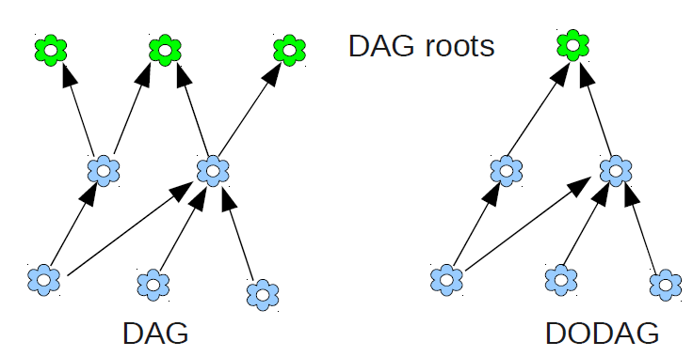
DAG and DODAG

Slide 71
Terminology
Virtual DODAG root: A Virtual DODAG root is the result of two or more RPL routers, for instance, 6LoWPAN Border Routers (6LBRs), coordinating to synchronize DODAG state and act in concert as if they are a single DODAG root (with multiple interfaces), with respect to the LLN.

Slide 72
Terminology
Up: Up refers to the direction from leaf nodes towards DODAG roots, following DODAG edges.
Down: Down refers to the direction from DODAG roots towards leaf nodes, in the reverse direction of DODAG edges.

Slide 73
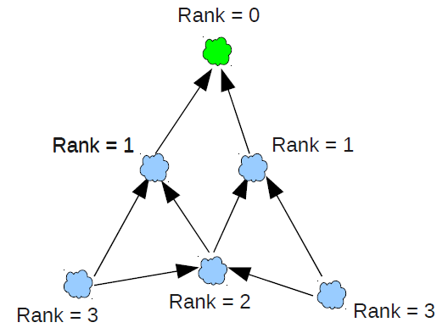
Terminology
Rank: A node’s Rank defines the node’s individual position relative to other nodes with respect to a DODAG root. Rank strictly increases in the Down direction and strictly decreases in the Up direction. The exact way Rank is computed depends on the DAG’s Objective Function (OF).

Slide 74
Terminology
Objective Function (OF): An OF defines how routing metrics, optimization objectives, and related functions are used to compute Rank.
Currently, two objective functions are defined
OF0: based on hop counts (no routing metrics)
Minimum rank with hysteresis objective function (MRHOF)
The rank computation is based on metrics (e.g. link quality) contained in DIO messages.
MRHOF works only for additive metrics

Slide 75
Terminology
Routing Metrics and constraints
LLN requires a sophisticated routing metric strategy driven by type of data traffic.
A metric is a scalar quantity used as input for best path selection.
A constraint is used to prune links or nodes that do not meet the set of constraints.
Metrics and constraints can be node or link based.
Examples of node level metrics are node state attribute, node energy state etc., while link level metrics can be latency, reliability, link color etc.

Slide 76
Terminology
Objective Code Point (OCP): An OCP is an identifier that indicates which Objective Function the DODAG uses.
RPLInstanceID: A RPLInstanceID is a unique identifier within a network. DODAGs with the same RPLInstanceID share the same Objective Function.
multi-topology routing (MTR)

Slide 77
Terminology
RPL Instance: A RPL Instance is a set of one or more DODAGs that share a RPLInstanceID.
DODAGID: identifier of a DODAG root.
DODAG Version: a specific iteration ("Version") of a DODAG with a given DODAGID
DODAGVersionNumber: a sequential counter that is incremented by the root to form a new Version of a DODAG. A DODAG Version is identified uniquely by the (RPLInstanceID, DODAGID, DODAGVersionNumber) tuple

Slide 78
Terminology
Grounded: A DODAG is grounded when the DODAG root can satisfy the Goal. (DAG's root is a border router)
Floating: A DODAG is floating if it is not grounded. (a subDAG's root may not be a border router)
DODAG parent: one of the immediate successors of the node on a path towards the DODAG root.
Sub-DODAG: The sub-DODAG of a node is the set of other nodes whose paths to the DODAG root pass through that node.

Slide 79
Terminology
DIO: DODAG Information Object
DAO: Destination Advertisement Object
DIS: DODAG Information Solicitation
CC: Consistency Check

Slide 80
RPLinstanceID
Multiple concurrent instances of RPL may operate in a given network, each of them is characterized by a unique RPLinstanceID.
Below, we describe the behavior of an individual RPL instance.
A RPL instance defines Optimization Objective when forming paths towards roots based on one or more metrics
Metrics may include both Link properties (Reliability, Latency) and Node properties (Powered on not)

Slide 81
Topology
RPL organizes a topology as a Directed Acyclic Graph (DAG) that is partitioned into one or more Destination Oriented DAGs (DODAGs), one DODAG per sink.
A RPLInstanceID identifies a set of one or more Destination Oriented DAGs (DODAGs).
The set of DODAGs identified by a RPLInstanceID is called a RPL Instance. All DODAGs in the same RPL Instance use the same OF.

Slide 82
Overview of DODAG Construction
Some nodes are configured to be DODAG roots, with associated DODAG configurations.
Nodes advertise their presence, affiliation with a DODAG, routing cost, and related metrics by sending link-local multicast DIO messages to all-RPL-nodes.
Nodes listen for DIOs and use their information to join a new DODAG (thus, selecting DODAG parents), or to maintain an existing DODAG, according to the specified Objective Function and Rank of their neighbors.
Nodes provision routing table entries, for the destinations specified by the DIO message, via their DODAG parents in the DODAG Version. Nodes that decide to join a DODAG can provision one or more DODAG parents as the next hop for the default route and a number of other external routes for the associated instance.
chooses parents that minimize path cost to the DODAG root

Slide 83
DODAG Construction (2nd view)
The root starts advertising the information about the graph using the DIO message.
The neighboring nodes of the root will receive and process DIO message potentially from multiple nodes and makes a decision based on certain rules (according to the objective function, DAG characteristics, advertised path cost and potentially local policy) whether to join the graph or not.
Once the node has joined a graph it has a route toward the graph (DODAG) root.
The graph root is termed as the ‘parent’ of the node.

Slide 84
DODAG Construction (2nd view)
The node computes the ‘rank’ of itself within the graph, which indicates the “coordinates” of the node in the graph hierarchy.
If configured to act as a router, it starts advertising the graph information with the new information to its neighboring peers.
If the node is a “leaf node”, it simply joins the graph and does not send any DIO message.
The neighboring peers will repeat this process and do parent selection, route addition and graph information advertisement using DIO messages.
This rippling effect builds the graph edges out from the root to the leaf nodes where the process terminates.

Slide 85
DODAG Construction (2nd view)
In this formation each node has a routing entry towards its parent (or multiple parents depending on the objective function) in a hop-by-hop fashion and the leaf nodes can send a data packet all the way to root of the graph by just forwarding the packet to its immediate parent.
This model represents a MP2P (Multipoint-to-point) forwarding model where each node of the graph has reach-ability toward the graph root. This is also referred to as UPWARD routing.

Slide 86
DODAG Construction (2nd view)
Each node in the graph has a ‘rank’ that is relative and represents an increasing coordinate of the relative position of the node with respect to the root in graph topology.
The notion of “rank” is used by RPL for various purposes including loop avoidance. The MP2P flow of traffic is called the ‘up’ direction in the DODAG.

Slide 87
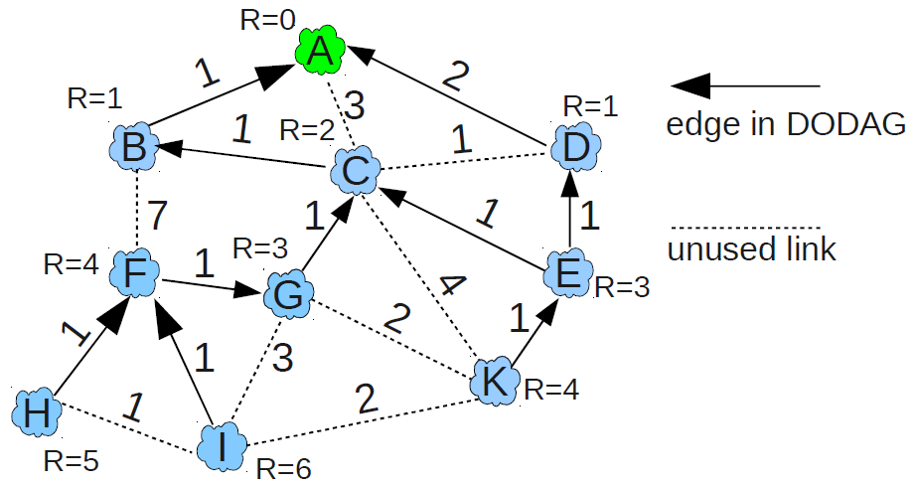
DODAG Example
Each node has a set of parent nodes
A node has no knowledge about children → ONLY upward routes

Slide 88
Routing Loop Detection
If a node receives a packet flagged as moving in the Upward direction, and if that packet records that the transmitter is of a lower (lesser) Rank than the receiving node, then the receiving node is able to conclude that the packet has not progressed in the Upward direction and that the DODAG is inconsistent.

Slide 89
Downward Routes
RPL uses Destination Advertisement Object (DAO) messages to establish Downward routes. (for P2MP or P2P) Two modes:
Storing (fully stateful)
packet may be directed Down towards the destination by a common ancestor of the source and the destination
Non-Storing (fully source routed)
packet will travel all the way to a DODAG root before traveling Down.(因為只有root存routing info.)
A mixed mode of operation is not allowed.

Slide 90
Downward Routing
Each RPL instance supporting download traffic selects one of the two models
“storing” model: nodes maintain routing tables
DAO message, including the prefixes and addresses reachable by the sending node, are sent to the parents.
Parents store the preferred downward routes and propagate aggregated DAOs upward.
“nonstoring” model: nodes use default routing upward and source routing downward
All downward traffic includes a source routing header specifying each hop along the path.
Intermediary routers don’t store any routing information .
The DAG root calculate an optional hop by hop source routing path for each advertised destination. (IPv6 routing extensions)
Messages will be much longer.
P2P traffic is always routed to the DAG root.

Slide 91
Storing Mode
DAO messages are used to advertise prefix reachability towards the leaf nodes in support of the ‘down’ traffic.
DAO carries prefix information, valid lifetime and other information about the distance of the prefix.
As each node joins the graph it will send DAO message to its parent set. Alternately, a node or root can poll the sub-dag for DAO message through an indication in the DIO message.
As each node receives the DAO message, it processes the prefix information and adds a routing entry in the routing table.

Slide 92
Storing Mode
It optionally aggregates the prefix information received from various nodes in the sub-dag and sends a DAO message to its parent set.
This process continues until the prefix information reaches the root and a complete path to the prefix is setup.

Slide 93
Non‐storing Mode
When a node A sends a packet to a node B within the RPL domain, the packet first follows the graph up to the root where the routing information is stored.
At this point, the graph root inspects the destination, consults its routing table that contains the path to the destination (obtained from DAO messages received).
The root “source -routes” the packet to its destination using a specific routing header for IPv6 (called RH4).

Slide 94
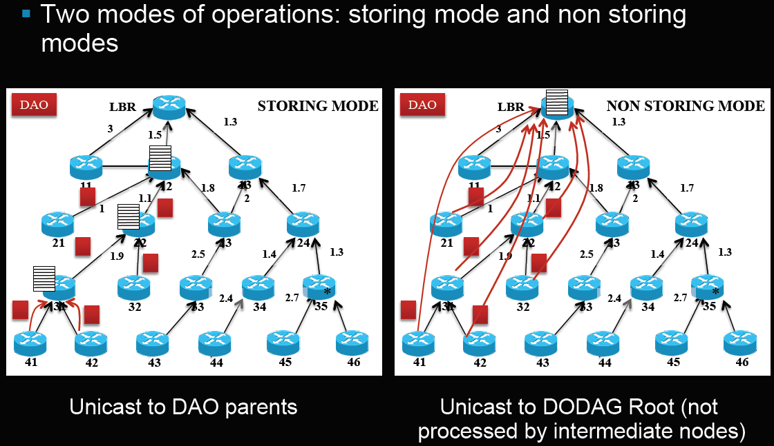
Two modes of Operation

Slide 95
RPL Control Messages
RPL Control message are ICMPv6 messages
DAG Information Object (DIO) - carries information that allows a node to discover an RPL Instance, learn its configuration parameters and select DODAG parents
DAG Information Solicitation (DIS) - solicit a DODAG Information Object from a RPL node
Destination Advertisement Object (DAO) - used to propagate destination information upwards along the DODAG.
DAO-ACK: Destination Advertisement Object Acknowledgement
+ The 4 secured versions

Slide 96
Control Message Exchange
Each DODAG, uniquely identified by RPLInstanceID and DODAGID, is incrementally built from the root to the leaf nodes.
RPL nodes send DIOs periodically via link-local multicasts.
Joining nodes may request DIOs from their neighbors by multicasting DIS (DODAG Information Solicitation) .
DTSN (Destination Advertisement Trigger Sequence Number) is a 8-bit unsigned integer set by the issuer of the message. In the storing mode, increasing DTSN is to request updated DAOs from child nodes.

Slide 97
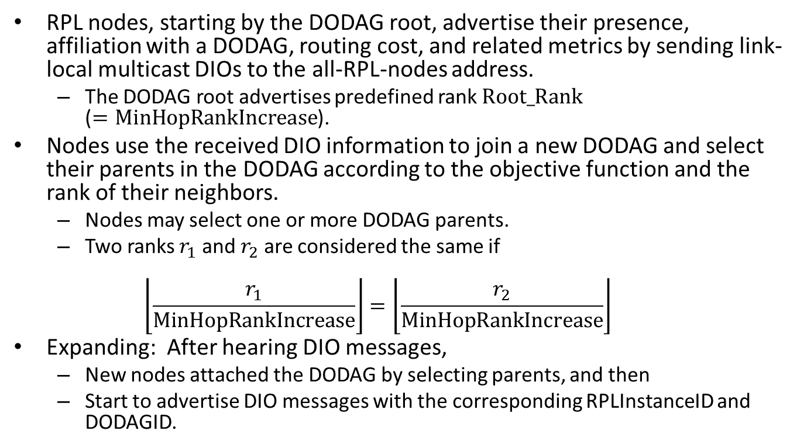
Build a DODAG

Slide 98
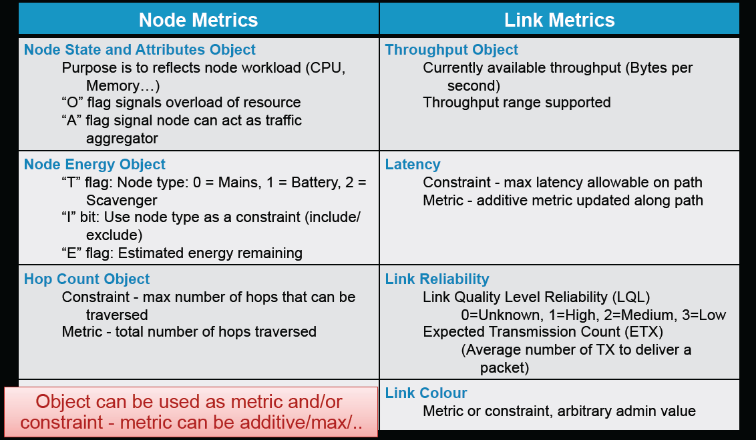
Routing Metrics in LLNs
Specified in draft-ietf-roll-routing-metrics
Reference: IoT Workshop RPL Tutorial, Cisco Systems

Slide 99
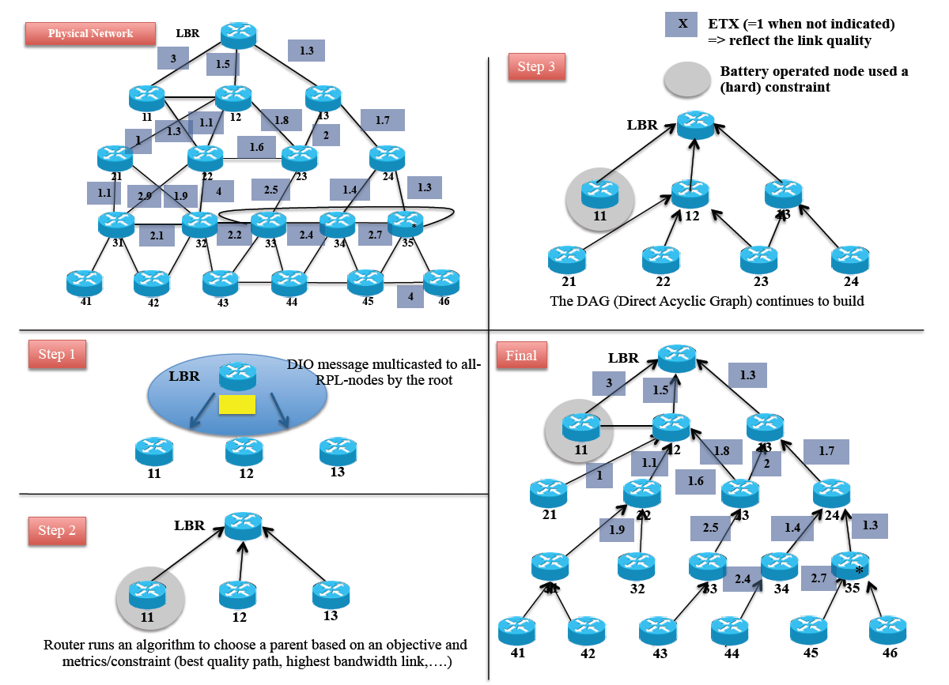
Building a DAG-Upward Routing
Reference: IoT Workshop RPL Tutorial, Cisco Systems

Slide 100
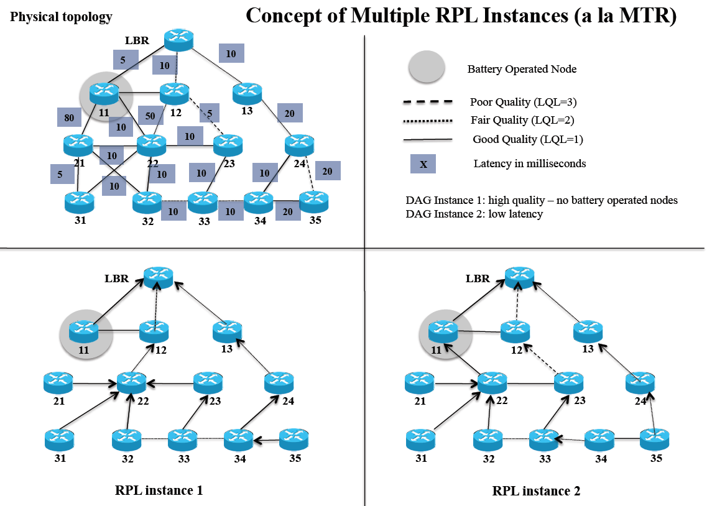
Multiple Instances of RPL

Slide 101
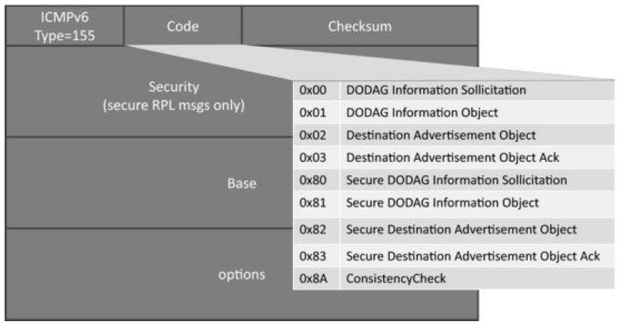
ICMPv6 RPL Control Message
DIS
DIO
DAO
DAO-ACK
Link-local scope: source is link-local unicast and destination=link-local
unicast or all-RPL-nodes(FF02::1) (for all RPL messages except DAO/
DAO-ACK in non storing mode, DIO replies to DIS)
Reference: Figure 12.7: Structure of ICMPv6 RPL control message

Slide 102
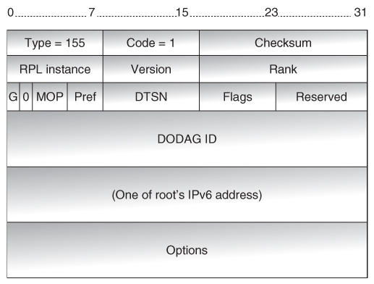
DODAG Information Object (DIO)
All nodes except “leaves” generate DIO periodically (controlled by Trickle).
A node uses the DIO messages received from its neighbor to determine their rank.
A node will select a set of possible parents and a preferred parent.

Slide 103
Trickle Timer
RPL uses an adaptive timer mechanism called the “trickle timer”
The algorithm treats building of graphs as a consistency problem and makes use of trickle timers to decide when to multicast DIO messages.
The interval of the trickle timer increases as the network stabilizes
Inconsistency events: loop, join, move, etc
As inconsistencies are detected, the nodes reset the trickle timer and send DIOs more often.

Slide 104
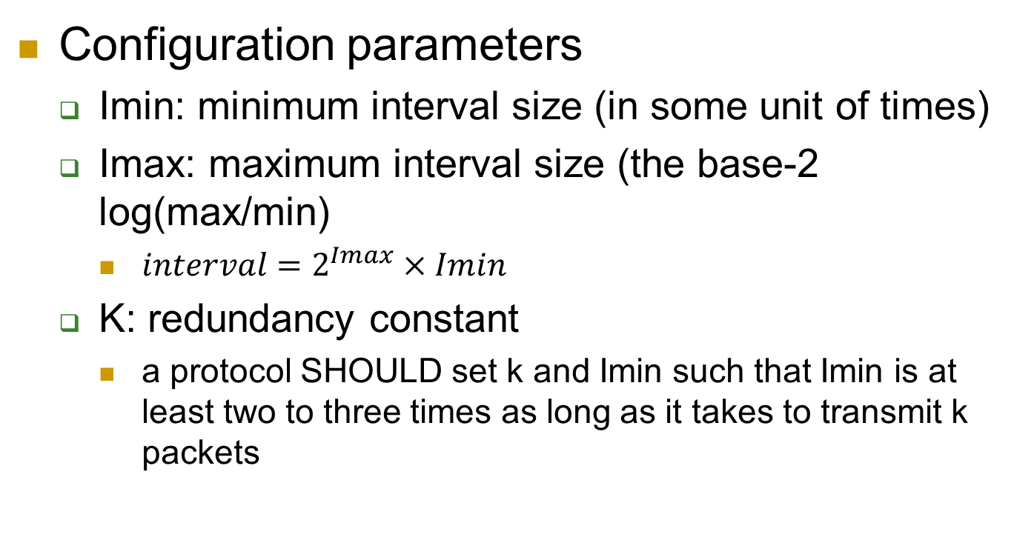
Trickle Algorithm

Slide 105
Trickle Algorithm
Node operation parameters
I: the current interval size
t: a time within the current interval; time to send a control packet
c: a consistent counter

Slide 106
Trickle Algorithm
Sets I to a value in the range of [Imin, Imax]
Starts an interval; resets c to 0; sets t to a random number from the range [I/2, I)
If receives a consistent transmission, c++
At time t, transmits a control packet iff c<k
When I expires, I=Max(2xI, Imax)
If receives an inconsistent transmission and I>Imin, resets I=Imin, starts a new interval; resets c to 0; t=random[I/2, I)

Slide 107
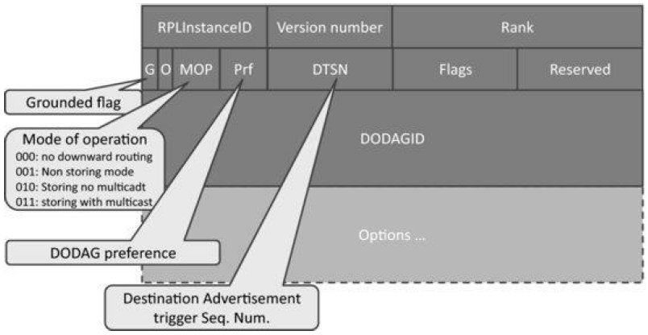
DODAG Information Object (DIO)
It is used to build the DODAG.
It carries general DODAG configuration parameters and information that allows listening RPL routers to select a set of DODAG parents.
Next Slide
Reference: Figure 12.8: RPL DIO base object (followed by options)

Slide 108
Options of RPL DIO
Option:
Type | Length | Data …
Option types
0x02: metric container option
Estimate the cost to reach destinations
0x03: routing information option
Contains the same fields as the IPv6 neighbor discovery route information option
0x04: DODAG information option
Constrain the rank a node can advertise when reattaching to a DODAG, or
The default lifetime of all RPL routes
0x08: prefix information option
Contains the same fields as the IPv6 neighbor discovery prefix option

Slide 109
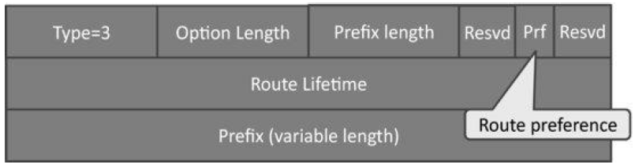
Routing Information Option (Type=3)
RPL nodes send DIOs periodically via link-local multicasts
Joining nodes may request DIOs from their neighbors by multicasting DIS
Reference: Figure 12.9: RPL Route Information option (Type=3)

Slide 110
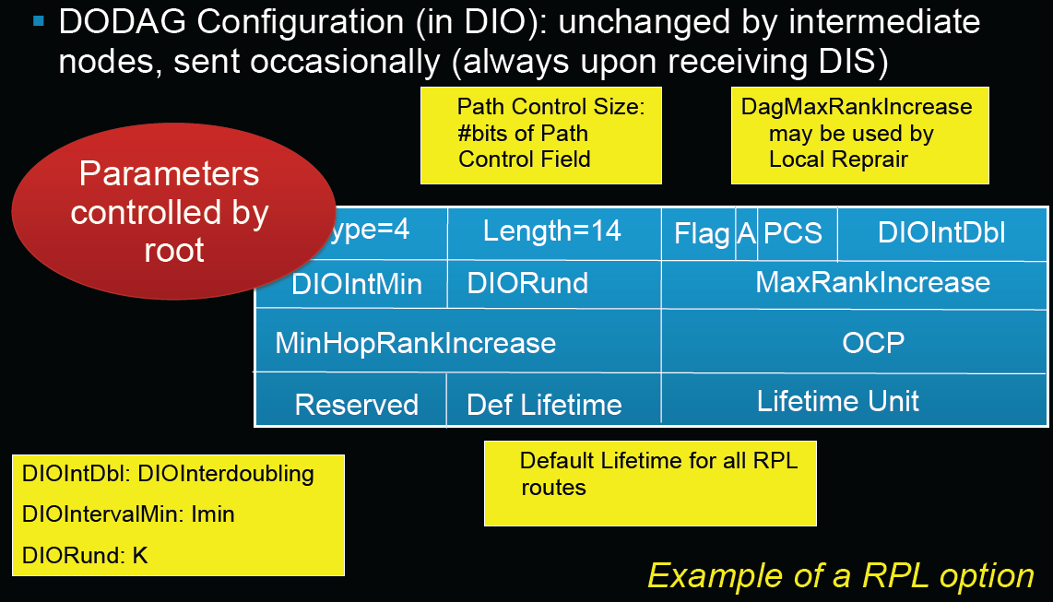
DODAG Information Option (Type=4)
Reference: Figure 12.8: RPL DIO base object (followed by options)

Slide 111
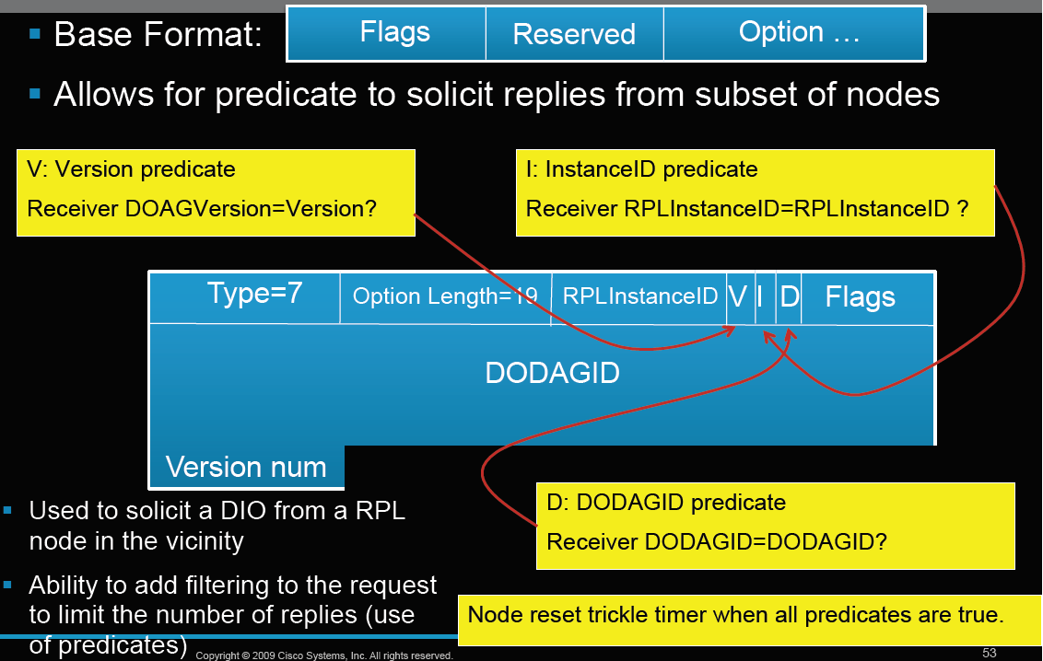
RPL DIS Message

Slide 112
Downward Routes and Destination Advertisement
Nodes inform parents of their presence and reachability to descendants by sending a DAO message
Node capable of maintaining routing state →aggregate routes
Node incapable of maintaining routing state → attach a next-hop address to the reverse route stack contained within the DAO message

Slide 113
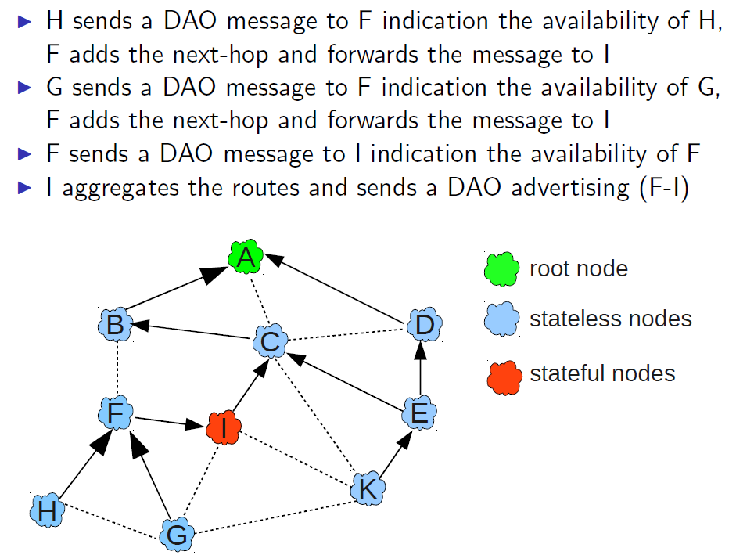
Destination Advertisement - Example
Source: Siarhei Kuryla, Networks and Distributed Systems seminar, March 2010

Slide 114
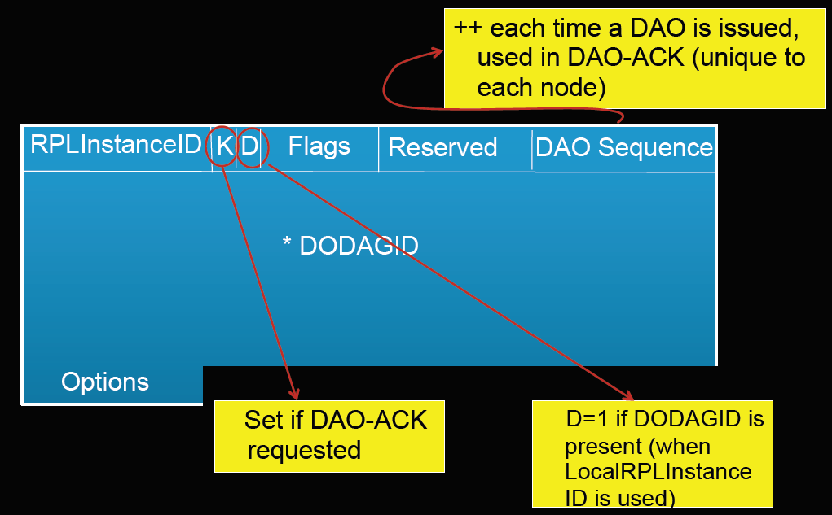
DAO Message

Slide 115
Conclusion
Optimized for many-to-one and one-to-many traffic patterns
Routing state is minimized: stateless nodes have to store only instance(s) configuration parameters and a list of parent nodes
Takes into account both link and node properties when choosing paths
Link failures does not trigger global network re-optimization

Slide 116
CoAP: Constrained Application Protocol
黃仁竑 教授
國立中正大學資工系

Slide 117
CoAP
The Constrained Application Protocol (CoAP) is defined by IETF CoRE WG for the manipulation of resources on a device that is on the constrained IP networks.
Notes:
CoAP
- IETF CoRE WG制定了限制應用協定去運用限制IP網路上裝置的資源。

Slide 118
What CoAP is (and is not)
CoAP is
A RESTful protocol
Both synchronous and asynchronous
For constrained devices and networks
Specialized for M2M applications
Easy to proxy to/from HTTP
CoAP is not
A replacement for HTTP
General HTTP compression
Separate from the web

Slide 119
CoRE Documents
Number | Title | Date | Status
RFC 7252 | The Constrained Application Protocol (CoAP) | June 2014 | Proposed Standard
RFC 7390 | Group Communication for the Constrained Application Protocol (CoAP) | October 2014 | Experimental
RFC 7641 | Observing Resources in the Constrained Application Protocol (CoAP) | September 2015 | Proposed Standard
RFC 7650 | A Constrained Application Protocol (CoAP) Usage for REsource LOcation And Discovery (RELOAD) | September 2015 | Proposed Standard

Slide 120
Constrained IP Networks
A constrained IP network has limited packet sizes, may exhibit a high degree of packet loss, and may have a substantial number of devices that may be powered off at any point in time but periodically "wake up" for brief periods of time.
These networks and the nodes within them are characterized by severe limits on throughput, available power, and particularly on the complexity that can be supported with limited code size and limited RAM per node.
Low-Power Wireless Personal Area Networks (LoWPANs) are an example of this type of network. Constrained networks can occur as part of home and building automation, energy management, and the Internet of Things.
Source: IETF CoRE WG
Notes:
限制IP網路
一個限制IP網路有有限的封包大小，可能造成高程度的封包遺失，而且可能有大量的裝置在任何時間點被關掉但週期性地一小段時間醒來。
他們之中的網路和節點被嚴格限制的流量、可用電力和特別在可以每個節點被有限編碼大小和有限RAM支持的複雜特性所描繪。
低功率無限個人區域網路是這種類型網路的例子。限制網路可以用在家裡的一部分和建築物自動化、能源控管和物聯網上。
來源: IETF CoRE WG

Slide 121
Devices on Constrained Networks
The general architecture consists of nodes on the constrained network, called Devices, that are responsible for one or more Resources that may represent sensors, actuators, combinations of values or other information.
Devices send messages to change and query resources on other Devices.
Devices can send notifications about changed resource values to Devices that have subscribed to receive notification about changes.
A Device can also publish or be queried about its resources.
Source: IETF IPv6 WG
Notes:
限制網路上的裝置
普遍的架構包含包含被稱作裝置的限制網路節點，負責其他一個或更多代表感應器、驅動器的資源。
裝置送訊息去改變和詢問其他裝置上的資源。
裝置可以送訂閱接收改變通知的裝置通知。
裝置可以發佈或被詢問他的資源。

Slide 122
Application Scope of CoAP
CoAP targets the type of operating environments defined in the ROLL and 6LOWPAN working groups which have additional constraints compared to normal IP networks, but the CoAP protocol will also operate over traditional IP networks.
This includes applications to monitor simple sensors (e.g. temperature sensors, light switches, and power meters), to control actuators (e.g. light switches, heating controllers, and door locks), and to manage devices.
Source: IETF IPv6 WG
Notes:
CoAP的應用範圍
CoAP
這包含應用程式去監測簡單的感測器(如溫度計、燈的開關和電錶)，去控制驅動器(如燈的開關、熱度控制器和門鎖)，且去管理裝置。

Slide 123
CoAP vs. HTTP
Like HTTP, the CoAP is a way of structuring REST communications but optimized for M2M applications.
TCP and HTTP are considered too heavy for 6LowPAN devices such as sensors. CoAP is thus based on UDP and a compressed simplified message exchange.
Notes:
CoAP、HTTP 比較
如HTTP，CoAP是一個為了M2M應用而最佳化的建構REST通訊方法。
TCP和HTTP被認為對於6LowPAN裝置如感測器而言太過厚重，CoAP因此建構在UDP和壓縮且簡化後的訊息交換。

Slide 124

CoAP RESTful Applications
Source: IETF IPv6 WG
Notes:
CoAP RESTful 應用

Slide 125

CoAP Server
https://www.slideshare.net/michaeljohnkoster/object-models-for-interoperability

Slide 126

CoAP Message Format
Ver - Version (1) 2-bit
T - Transaction Type 2-bit
CON (0) – Confirmable
NON (1) – Non-Confirmable
ACK (2) – Acknowledgement
RST (3) – Reset
Token Length (TKL): 4-bit
Code – 3-bit class, 5-bit detail ("c.dd“)
Class: request (0), success response (2), client error response (4), server error response (5).
Message ID - Identifier for matching responses
Token - used to correlate requests and responses.
Notes:
CoAP 訊息標準
Ver : 版本
T : 執行類型
- CON : 可確認的
- NON : 不可確認的
- ACK : 回復確認
- REST : 重置
OC : 選擇數，這個標頭之後的選擇個數
Code : 要求方法(1-10)或回應碼(40-255)
Message ID : 用做配對回復的識別符

Slide 127
CoAP Code and Message ID
Code: compressed from HTTP text representation (3 numbers) into one byte
HTTP requests =>first 3 bits 000; next five bits 0~32 (1: GET; 2: POST; 3:PUT; 4:DELETE etc.)
HTTP responses=>first 3 bits 001-101 (1~5) representing the first number of 2xx: success, 4xx: client error, 5xx: server error; xx represented by next five bits 00001~01111 (1~15 used only; e.g. with HTTP response 201 is represented as 010-00001; HTTP response 400 is represented as 100-00000 etc.)
Message ID: used in the acknowledgment process to tie a request with a response.
Notes:
CoAP 碼和訊息ID
碼 : 從HTTP 文字表達(3碼)壓縮到一個位元組
- HTTP 要求 => 第一個三位元000; 下一個五位元0~32(1:GET, 2:POST, 3:PUT, 4:DELETE …等等)
- HTTP 為應 => 第一個三位元001-101(1~5)表示1xx的第一個數字:資訊的，2xx:成功，3xx:充新導向，4xx:客戶端錯誤，5xx:伺服器錯誤，其中xx由下五位位元表示。 0001~0111(只有1~15被使用)，舉例來說HTTP回復201由010-00001代表，HTTP回復400由100-0000代表等等。
訊息 ID : 被使用在綁一個要求到回應的確認程序

Slide 128

CoAP Options
Option Delta - Difference between this option type and the previous
Length - Length of the option value (0-270)
Value - The value of Length bytes immediately follows Length
Notes:
CoAP 選擇
Option Delta – 這個選擇類型和先前的差異
Length – 選擇值的長度(0-270)
Value – 緊接長度後面的長度位元組值

Slide 129
Options
CoAP defines a single set of options that are used in both requests and responses:
Content-Format
ETag
Location-Path
Location-Query
Max-Age
Proxy-Uri
Proxy-Scheme
Uri-Host
Uri-Path
Uri-Port
Uri-Query
Accept
If-Match
If-None-Match
Size1
Notes:
CoAP 碼和訊息ID
碼 : 從HTTP 文字表達(3碼)壓縮到一個位元組
- HTTP 要求 => 第一個三位元000; 下一個五位元0~32(1:GET, 2:POST, 3:PUT, 4:DELETE …等等)
- HTTP 為應 => 第一個三位元001-101(1~5)表示1xx的第一個數字:資訊的，2xx:成功，3xx:充新導向，4xx:客戶端錯誤，5xx:伺服器錯誤，其中xx由下五位位元表示。 0001~0111(只有1~15被使用)，舉例來說HTTP回復201由010-00001代表，HTTP回復400由100-0000代表等等。
訊息 ID : 被使用在綁一個要求到回應的確認程序

Slide 130

Examples of Option types
C=Critical U=Unsafe N=NoCacheKey R=Repeatable
4 (Etag) entity tag: proxy can assign entity tags to responses it sends to a client
14 (Max-Age) gives the maximum duration in seconds for which the answer may
be cached.
19 (Token) is used to match a response with a request.
6 (Observe) is used to receive regularly updated values from the server.
RFC 7641: Observing Resources in CoAP.
23, 27 (Block2, Block1) is used to transfer blocks of responses (Work in Progress)
Notes:
選擇類型的例子
1 (Content-Type) 是關於描述承載區塊語法的多用途網路郵件擴展值，舉例來說，0: test/plain，44: application/soap+xml
2 (Max-Age) 在回答被快取的幾秒間給最大值
4 (Etag)
10 (Observe) 被用在接受伺服器規律地更新值
11 (Token) 被用在要求和回復的配對
16 (Block) 被用再傳送回應的區塊

Slide 131
CoAP Methods
CoAP makes use of GET, PUT, POST, and DELETE methods in a similar manner to HTTP.
New methods can be added, and do not necessarily have to use requests and responses in pairs.
For example: OBSERVE

Slide 132
CoAP URI
coap-URI = "coap:" "//" host [ ":" port ] path-abempty [ "?" query ]
coap://example.com:5683/˜sensors/temp.xml
coap://EXAMPLE.com/%7Esensors/temp.xml
coaps-URI = "coaps:" "//" host [ ":" port ] path-abempty [ "?" query ]

Slide 133

Messaging Model
Reliable Message Transmission:
Reliability is provided by marking a message as Confirmable (CON).
A Confirmable message is retransmitted using a default timeout and exponential back-off between retransmissions, until the recipient sends an Acknowledgement message.
Notes:
CoAP 碼和訊息ID
碼 : 從HTTP 文字表達(3碼)壓縮到一個位元組
- HTTP 要求 => 第一個三位元000; 下一個五位元0~32(1:GET, 2:POST, 3:PUT, 4:DELETE …等等)
- HTTP 為應 => 第一個三位元001-101(1~5)表示1xx的第一個數字:資訊的，2xx:成功，3xx:充新導向，4xx:客戶端錯誤，5xx:伺服器錯誤，其中xx由下五位位元表示。 0001~0111(只有1~15被使用)，舉例來說HTTP回復201由010-00001代表，HTTP回復400由100-0000代表等等。
訊息 ID : 被使用在綁一個要求到回應的確認程序

Slide 134

Messaging Model
Unreliable Message Transmission:
A message that does not require reliable transmission can be sent as a Non-confirmable message (NON).
These are not acknowledged.
Notes:
CoAP 碼和訊息ID
碼 : 從HTTP 文字表達(3碼)壓縮到一個位元組
- HTTP 要求 => 第一個三位元000; 下一個五位元0~32(1:GET, 2:POST, 3:PUT, 4:DELETE …等等)
- HTTP 為應 => 第一個三位元001-101(1~5)表示1xx的第一個數字:資訊的，2xx:成功，3xx:充新導向，4xx:客戶端錯誤，5xx:伺服器錯誤，其中xx由下五位位元表示。 0001~0111(只有1~15被使用)，舉例來說HTTP回復201由010-00001代表，HTTP回復400由100-0000代表等等。
訊息 ID : 被使用在綁一個要求到回應的確認程序

Slide 135
Example 1 of CoAP Requests
Synchronous Message Exchange
A CONfirmable message followed
by ACKowledgement piggybacked
with the response in the same
Message ID (MID).
2. When ACKnowledgment was
lost, Client’s timer expires and
it resends the message.
3. Exponential back-off between
retransmissions.
Source: M2M Communications: A Systems Approach, Wiley, 2012
Notes:
CoAP要求的例子一
同步訊息交換
一個可確認的訊息用相同訊息ID在回應夾帶的回應回覆之後。
當回應回復遺失，客戶端的計時過期它重送訊息。

Slide 136

Example 2a of CoAP Requests
Asynchronous Message Exchange
A CONfirmable message with TOKEN
option can be acknowledged immediately
with an Empty Acknowledgement.
2. When the response is available,
it can be returned in a new CON
message with the same TOKEN
ID.
Notes:
CoAP要求的例子二
非同步訊息交換
1. 一個有標記選項可確認的訊息可以馬上被通知收到不用回覆。
2. 當回覆是可使用的，它可以以相同標誌ID的新的CON訊息回傳

Slide 137

Example 2b of CoAP Requests
Asynchronous Message Exchange
A Non-confirmable message with TOKEN
then the response is sent using a new
Non-confirmable message, although the
server may instead send a Confirmable
message.
Notes:
CoAP要求的例子二
非同步訊息交換
1. 一個有標記選項可確認的訊息可以馬上被通知收到不用回覆。
2. 當回覆是可使用的，它可以以相同標誌ID的新的CON訊息回傳

Slide 138
Example 3a of CoAP Requests (OBSERVE)
Periodic response from a server
A CONfirmable message from the client
contains OBSERVE option asking periodic
responses from the server.
2. The server send NON responses with the
same TOKEN ID.
3. OBSERVE is the response will be increased to
indicate the order of the response.
4. The client will ignore OBSERVE=20 since
it arrives later than OBSERVE=30.
5. Either client or server can terminate the
process.
Source: M2M Communications: A Systems Approach, Wiley, 2012
Notes:
CoAP要求的例子三
伺服器週期地回復
1. 一個來自客戶端可確認的訊息包含從伺服器詢問周期性回覆的OBSERVE選項。
2. 伺服器用相同TOKEN ID送NON回復。
3. OVSERVE是個將由增加指出順序的回覆。
4. 客戶端將忽略OVSERVE=20當它比OVSERVE=30晚到的時候。
5: 客戶端或伺服器都可以結束行程。

Slide 139

Example 3b of CoAP Requests (OBSERVE)
A notification can be confirmable or non-confirmable.
The server may send a notification in a confirmable CoAP message to request an acknowledgement from the client.
Notes:
CoAP要求的例子三
伺服器週期地回復
1. 一個來自客戶端可確認的訊息包含從伺服器詢問周期性回覆的OBSERVE選項。
2. 伺服器用相同TOKEN ID送NON回復。
3. OVSERVE是個將由增加指出順序的回覆。
4. 客戶端將忽略OVSERVE=20當它比OVSERVE=30晚到的時候。
5: 客戶端或伺服器都可以結束行程。

Slide 140
Example 4 of CoAP Requests
Source: IETF IPv6 WG
Block Transfer from Server to Client
A CONfirmable message from Client to get information.
2. Server indicates it has block of information to send.
3. Client then asks for more blocks of information.
Notes:
CoAP要求的例子四
從伺服器到客戶端的區塊傳輸
由從客戶端來的可確認訊息去取得資訊。
伺服器指出它有區塊的資訊要送。
客戶端之後要求更多區塊的資訊。

Slide 141
Proxying and Caching
Within 30s
Source: IETF IPv6 WG
Notes:
代理和快取

Slide 142
CoAP Caching Model
Cacheability determined by response code
• Freshness model
– Max-Age option indicates cache lifetime
• Validation model
– Validity checked using the Etag Option (http://en.wikipedia.org/wiki/HTTP_ETag)
Cacheability of CoAP responses depends on the Response Code.
Notes:
CoAP 快取模組
回覆碼決定可快取能力
新鮮的模組
最大年齡選項指出快取的生命週期
確認的模組
用Etag選項做正確性檢查
(http://en.wikipedia.org/wiki/HTTP_ETag)

Slide 143
CoAP Resource Discovery
Resource Discovery with CoRE Link Format
Discovering the links hosted by CoAP servers
GET /.well-known/core
Returns a link-header style format based on RFC5988 including URL, relation, type, interface, content-type etc.
See RFC 6690: Constrained RESTful Environments (CoRE) Link Format
Notes:
CoAP 資源探索
用CoRE連結形式做資源探索
探索CoAP伺服器為本地端的連結。
GET /.well-known/core 。
回傳一個架構在RFC5988連結標頭形式包括URL、關係、類型、介面、內容類型等等。
看draft-ietf-core-line-format。

Slide 144
RFC 6690 Link Format
Link = link-value-list
link-value-list = [ link-value *[ "," link-value ]]
link-value = "<" URI-Reference ">" *( ";" link-param )
link-param = ( ( "rel" "=" relation-types )
/ ( "anchor" "=" DQUOTE URI-Reference DQUOTE )
/ ( "rev" "=" relation-types )
/ ( "hreflang" "=" Language-Tag )
/ ( "media" "=" ( MediaDesc
/ ( DQUOTE MediaDesc DQUOTE ) ) )
/ ( "title" "=" quoted-string )
/ ( "title*" "=" ext-value )
/ ( "type" "=" ( media-type / quoted-mt ) )
/ ( "rt" "=" relation-types )
/ ( "if" "=" relation-types )
/ ( "sz" "=" cardinal )
/ ( link-extension ) )

Slide 145

Example of Resource Discovery
</light>;rt="Illuminance";ct=0,
</s/maastr.xml>;title="Maastricht weather";ct=1,
</s/maastr/temp>;title="Temperature in Maastrich";ct=1,
</s/oulu.xml>;title="Oulu weather";ct=1,
</s/oulu/temp>;title="Temperature in Oulu";ct=1,
</s/temp>;rt="Temperature";ct=0
Source: IETF IPv6 WG
Resource Type ‘rt’ Attribute
Interface Description ‘if’ Attribute
Notes:
資源探索的例子

Slide 146
Example of Resource Discovery
REQ: GET /.well-known/core
RES: 2.05 Content
</sensors/temp>;if="sensor",
</sensors/light>;if="sensor“
REQ: GET /.well-known/core
RES: 2.05 Content
</sensors>;ct=40
REQ: GET /sensors
RES: 2.05 Content
</sensors/temp>;rt="temperature-c";if="sensor",
</sensors/light>;rt="light-lux";if="sensor"
Source: IETF IPv6 WG
Notes:
資源探索的例子

Slide 147
Summary
CoAP is applicable to any IP networks.
Open source software available for these protocols.
http://coapy.sourceforge.net/index.html
CoAPy: Constrained Application Protocol in Python
Notes:
總結
我們介紹了四個IoT/M2M應用重要的IP協定
IPv6
6LoWPAN
RPL
CoAP
6LoWPAN,RPL和CoAP特別用在LLN的802.15.4類型; 然而CoAP對於任何IP網路也是可使用的
這些協定開放原始碼軟體可使用

Slide 148

Q&A

